Slide 1
Towards End-to-End Reinforcement Learning of Dialogue Agents for Information Access
Bhuwan Dhingra, Lihong Li, Xiujun Li, Jianfeng Gao, Yun-Nung Chen, Faisal Ahmed, Li Deng

Slide 2
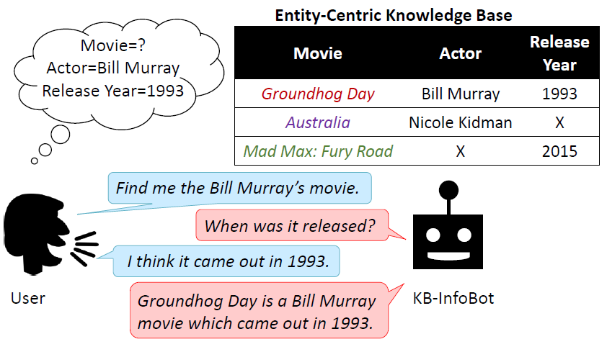
Overview
Task
KB-InfoBots, navigates a Knowledge Base (KB) in search of an entity
Motivation
Hard-KB lookup has two drawbacks:
No not carry any information about uncertainty in semantic parsing
Non differentiable, trained separately
Motivated by some related works
Contribution
Probabilistic framework(Soft-KB lookup), differentiable, end-to-end trainable
Reinforcement learners
Multi-turn
Notes:
Related works:
querying KBs via natural language in a fully “neuralized” way
Multi-turns by observations

Slide 3
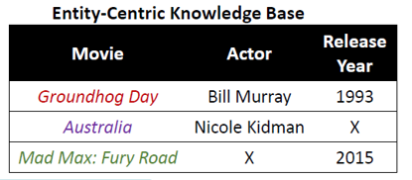
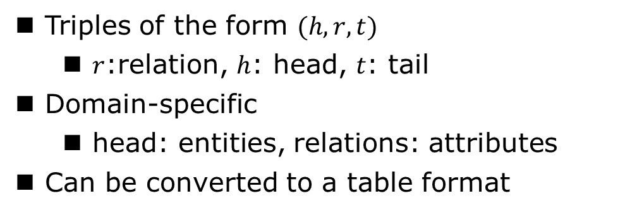
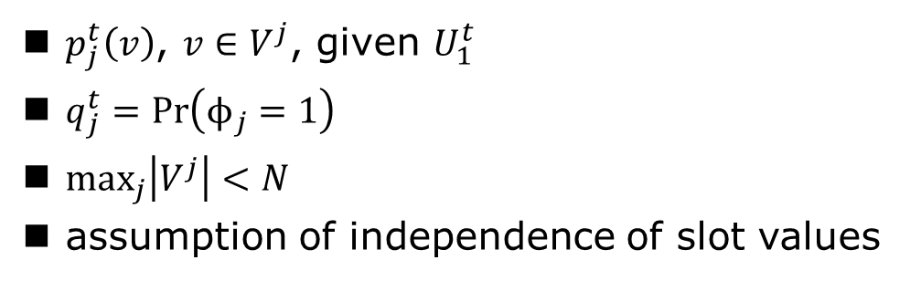
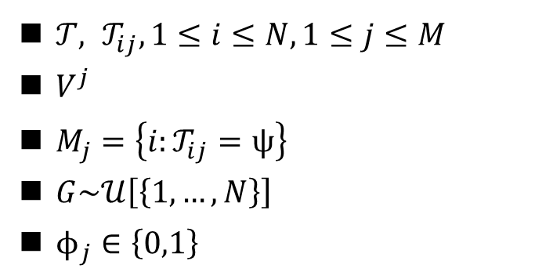
Probabilistic KB Lookup
Entity-Centric Knowledge Base (EC-KB)
Triples of the form $(h, r, t)$
$r$:relation, $h$: head, $t$: tail
Domain-specific
head: entities, relations: attributes
Can be converted to a table format
Notations and Assumptions
$𝒯, 𝒯_{ij},1≤i≤N, 1≤j≤M$
$V^{j}$
$M_{j}=\left\{i:𝒯_{ij}=ψ\right\}$
$G\sim 𝒰\left[\left\{1,…,N\right\}\right]$
$ϕ_{j}∈\left\{0,1\right\}$
$p_{j}^{t}\left(v\right)$, $v∈V^{j}$, given $U_{1}^{t}$
$q_{j}^{t}=Pr\left(ϕ_{j}=1\right)$
$\max_{j}\left|V^{j}\right|<N$
assumption of independence of slot values
Notes:
符号的解释：
G：行上的均匀先验
p: 用户约束……
max：该假设减少了模型参数

Slide 4


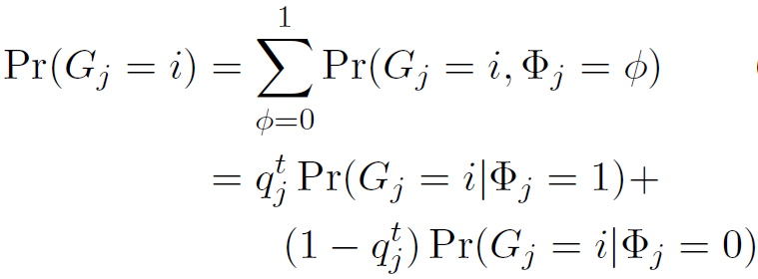
Probabilistic KB Lookup
Soft-KB Lookup
The posterior probability that the user is interested in row $i$ of the table
From the assumption of independence of slot values
The posterior probability of user goal for slot $j$ pointing to $𝒯_{ij}$
Notes:
目标是算后验概率$p_{𝒯}^{t}\left(i\right)$
后文方便起见都把$U_{1}^{t}$省略
解释符号：G，$ϕ$, q

Slide 5

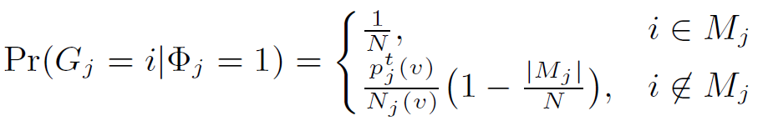



Probabilistic KB Lookup
Soft-KB Lookup
For $ϕ_{j}=0$:
For $ϕ_{j}=1$:
$N_{j}(v)$: the count of value $v$ in slot $j$
derivation
Notes:
推导见附录
解释符号：$M_{j}$
Soft-KB lookup method has two benefits over the Hard-KB method – (1) it helps the agent discover better dialogue policies by providing it more information from the language understanding unit, (2) it allows end-to-end training of both dialogue policy and language understanding in an online setting. In this section we describe several agents to test these claims

Slide 6
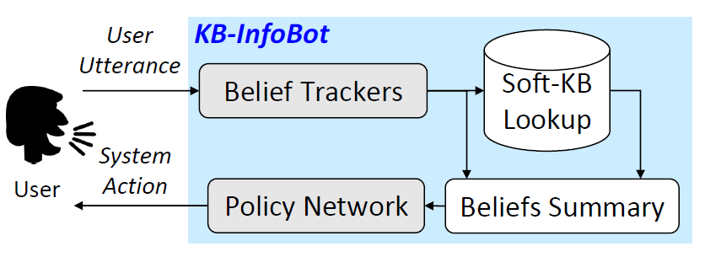
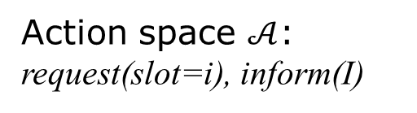


End-to-End-KB-InfoBot
$$u_{t}$$
$$a_{t}$$
Action space $𝒜$:
request(slot=i), inform(I)
And a template based Natural Language Generator (NLG) : converting dialogue acts into natural language.
Notes:
灰色是可训练参数
Modular approach, consisting of: a belief tracker module for identifying user intents, extracting associated slots, and tracking the dialogue state
an interface with the database to query for relevant results (Soft-KB lookup)
a summary module to summarize the state into a vector
a dialogue policy which selects the next system action based on current state
动作有M+1种

Slide 7
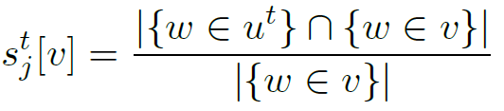
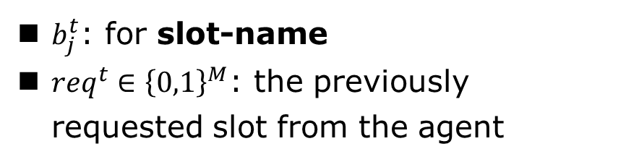
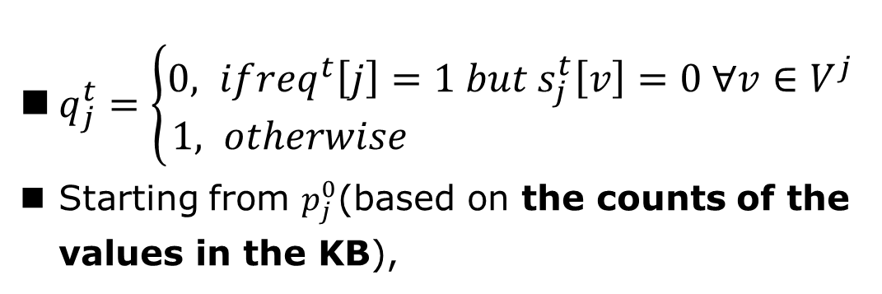
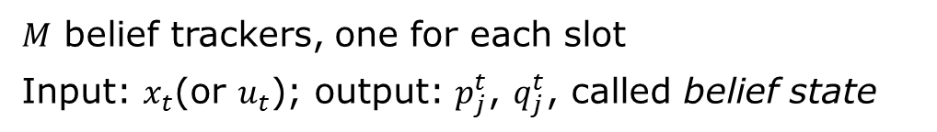
End-to-End-KB-InfoBot
Belief Trackers
$M$ belief trackers, one for each slot
Input: $x_{t}$(or $u_{t}$); output: $p_{j}^{t}$, $q_{j}^{t}$, called belief state
Hand-Crafted Tracker
Token-level keyword search
For slot-value, matching score
$q_{j}^{t}=\left\{\begin{aligned}0, if{req}^{t}\left[j\right]=1 but s_{j}^{t}\left[v\right]=0 ∀v∈V^{j} \\ &1, otherwise \end{aligned}\right.$
Starting from $p_{j}^{0}$(based on the counts of the values in the KB),
$b_{j}^{t}$: for slot-name
${req}^{t}∈{\left\{0,1\right\}}^{M}$: the previously requested slot from the agent
Notes:
C is a tuning parameter
And normalization

Slide 8

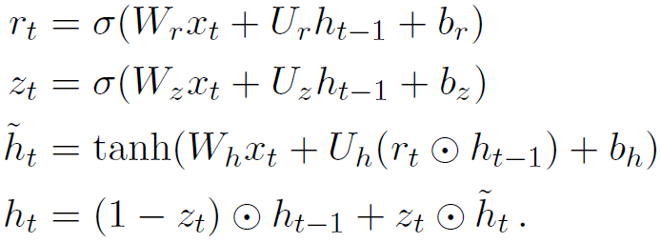
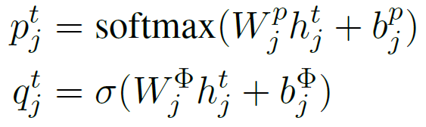


End-to-End-KB-InfoBot
Belief Trackers
$M$ belief trackers, one for each slot
Input: $x_{t}$(or $u_{t}$); output: $p_{j}^{t}$, $q_{j}^{t}$, called belief state
Neural Belief Tracker
$u_{t}$ is converted to a vector representation $x_{t}$, using a bag of $n$-grams (with $n=2$)
GRU:
Notes:
附录内容：GRU展开
最后一行各符号都是可训练参数

Slide 9

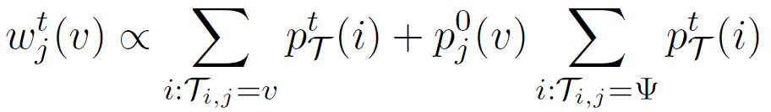
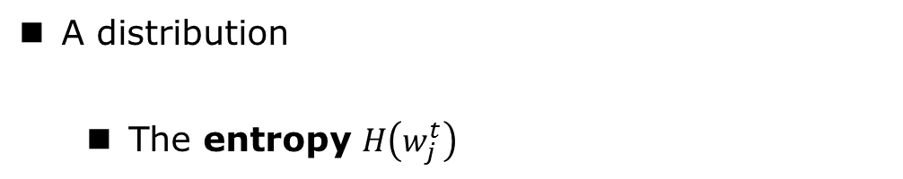

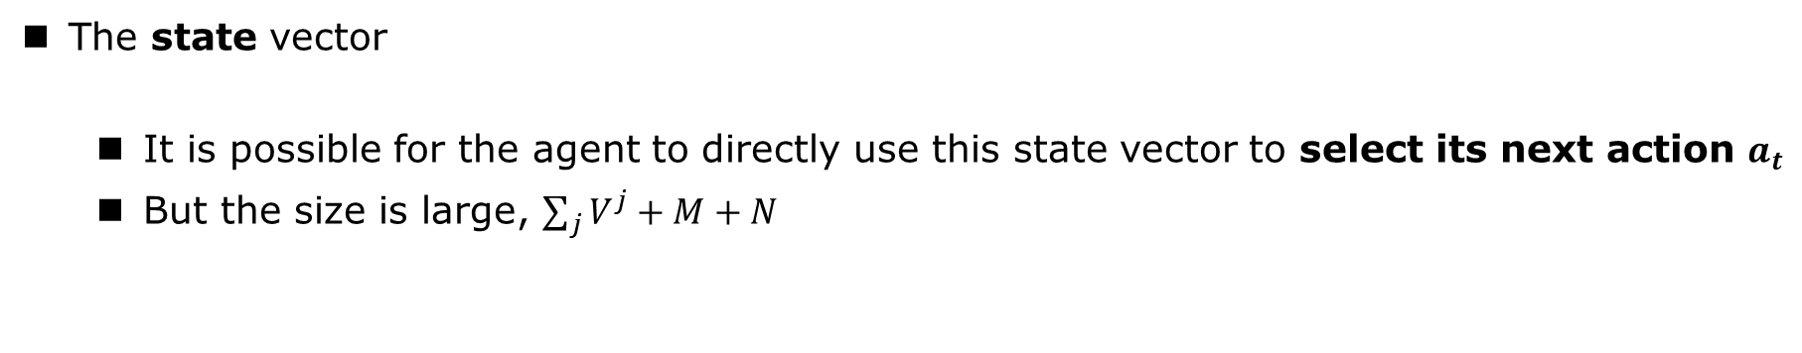
End-to-End-KB-InfoBot
Soft-KB Lookup + Summary
$$\left(p_{j}^{t}\text{, }q_{j}^{t}\right) →p_{𝒯}^{t}→{\tilde{s}}^{t}$$
Soft-KB lookup
Compute the posterior $p_{𝒯}^{t}∈ℝ^{N}$from $\left(p_{j}^{t}\text{, }q_{j}^{t}\right)$
Summary
The state vector
It is possible for the agent to directly use this state vector to select its next action $a_{t}$
But the size is large, $\sum_{j}{V^{j}+M+N}$
A distribution
The entropy $H\left(w_{j}^{t}\right)$
The final summary vector, which has size $2M+1$
Notes:
这里的p~是w吗

Slide 10

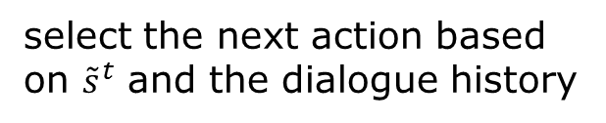
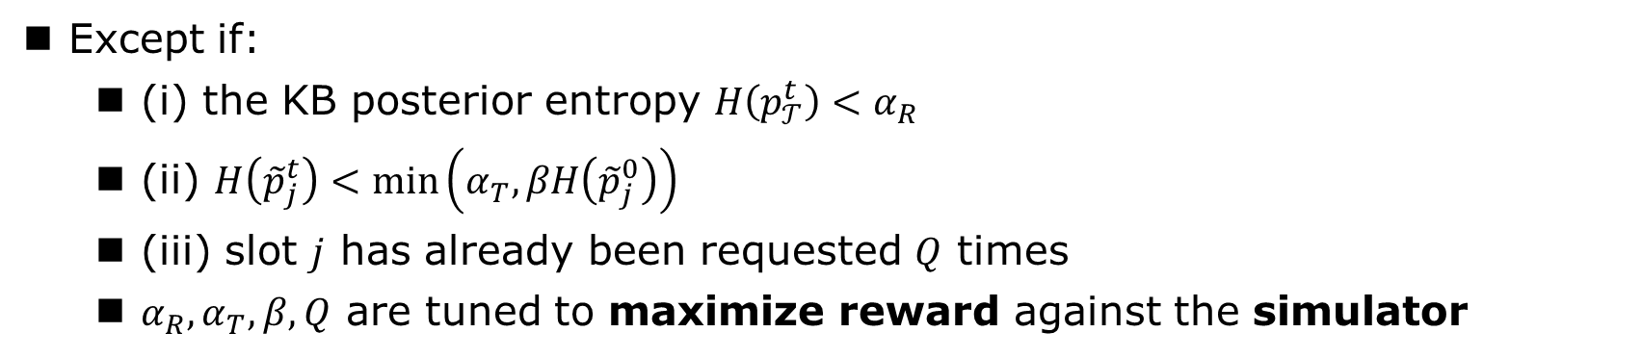
End-to-End-KB-InfoBot
Dialogue Policy
select the next action based on ${\tilde{s}}^{t}$ and the dialogue history
Hand-Crafted Policy
Asks for the slot
Except if:
(i) the KB posterior entropy $H\left(p_{𝒯}^{t}\right)<α_{R}$
(ii) $H\left({\tilde{p}}_{j}^{t}\right)<\min\left(α_{T},βH\left({\tilde{p}}_{j}^{0}\right)\right)$
(iii) slot $j$ has already been requested $Q$ times
$α_{R},α_{T},β,Q$ are tuned to maximize reward against the simulator
Notes:
s~t是state

Slide 11
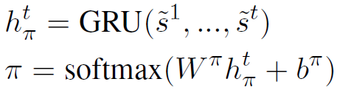



End-to-End-KB-InfoBot
Dialogue Policy
select the next action based on ${\tilde{s}}^{t}$ and the dialogue history
Neural Policy Network
Compute policy $π$
During training, the agent samples its actions from the policy to encourage exploration
For action inform(), need to provide entities
by sampling $R$ items from the KB-posterior $p_{𝒯}^{t}$

Slide 12
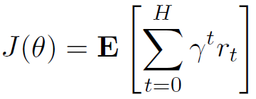
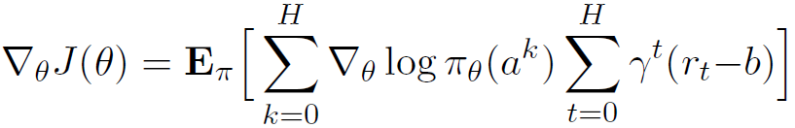
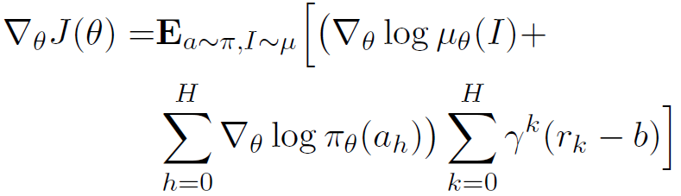

Training
REINFORCE algorithm
The expected discounted return of the agent under policy $π$
Updates are given by
For end-to-end training we need to update both the dialogue policy and the belief trackers using the reinforcement signal
$b$:a baseline reward signal
derivation
Notes:
view the KB posterior as another policy

Slide 13
Training
Imitation Learning (IL) phase
In the case of end-to-end learning, the agent almost always fails if starting from random initialization.
In this case, credit assignment is difficult for the agent, since it does not know whether the failure is due to an incorrect sequence of actions or incorrect set of results from the KB.
Hence, at the beginning of training, the belief trackers and policy network are trained to mimic the hand-crafted agents
The loss function
${\hat{p}}_{j}^{t},{\hat{q}}_{j}^{t}$: the belief states from a rule-based agent, ${\hat{a}}^{t}$: its action at turn t
Notes:
D(p||q) and H(p, q) denote the KL divergence and cross-entropy between p and q respectively.
可加框框

Slide 14
Experiments and Results
KB-InfoBot versions
Two belief trackers – (A) Hand- Crafted and (B) Neural
Two dialogue policies – (C) Hand-Crafted and (D) Neural
Rule agent: A+C
RL agent: A+D
E2E agent: B+D
No-KB
Hard-KB
Soft-KB
They differ only in the inputs to the dialogue policy
Hyperparameters
Notes:
For the RL agents, we also append ${\hat{q}}_{j}^{t}$and a one-hot encoding of the previous agent action to the policy network input
3 variants:
The No-KB version only takes entropy H(ˆptj) of each of the slot distributions.
The Hard-KB version performs a hard-KB lookup and selects the next action based on the entropy of the slots over retrieved results. This is the same approach as in Wen et al. (2016b), except that we take entropy instead of summing probabilities.
The difference only lies in the policy for action selection
The Soft-KB version takes summary statistics of the slots and KB posterior described in Section 4.

Slide 15
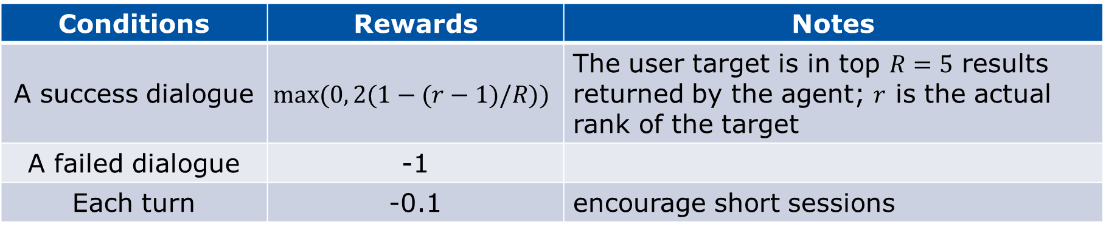
Experiments and Results
User Simulator
When training, reinforcement learners need an environment to operate in.
The publicly-available user simulator presented in Li et al. (2016b)
The simulated user provides a reward signal at the end of each dialogue:
Conditions | Rewards | Notes
A success dialogue | $$max⁡(0, 2(1−(r−1)/R))$$ | The user target is in top $R=5$ results returned by the agent; $r$ is the actual rank of the target
A failed dialogue | -1
Each turn | -0.1 | encourage short sessions
Note: The maximum length of a dialogue is 10 turns beyond which it is deemed a failure.
Notes:
具体解释下模拟用户的流程：
随机采样Entity+slots->给slot的子集->如果收到request，知道则返回，不知道通知不知道->如果收到结果，检查target在不在，计算返回reward
NLG：DA转化为自然语言
The NLG is trained in a sequence-to-sequence fashion, using conversations between humans collected by crowd-sourcing.
DA->template-like sentences with slot placeholders->replace the slot placeholders with their actual values
By increasing the temperature of the output softmax in the NLG we can increase the noise in user utterances.

Slide 16
Experiments and Results
EC-KB
User Simulator
randomly,
target entity+slots
The process
User simulator
a subset of slots
Agent
request()
value or not know
inform()
reward
NLG: convert dialogue acts from the user (user simulator here) into natural language utterances
Trained in a sequence-to-sequence fashion
Could increase the noise
Notes:
具体解释下模拟用户的流程：
随机采样Entity+slots->给slot的子集->如果收到request，知道则返回，不知道通知不知道->如果收到结果，检查target在不在，计算返回reward
NLG：DA转化为自然语言
The NLG is trained in a sequence-to-sequence fashion, using conversations between humans collected by crowd-sourcing.
DA-->template-like sentences with slot placeholders via an LSTM decoder-->replace the slot placeholders with their actual values via a post-processing scan
By increasing the temperature of the output softmax in the NLG we can increase the noise in user utterances.

Slide 17
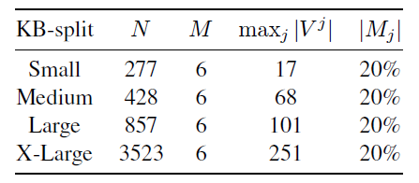
Experiments and Results
Movies-KB
IMDBPy package
Reduce the number of actors and directors in order to make the task more challenging
Randomly remove 20% of the values from the agent’s copy of the KB to simulate a scenario where the KB may be incomplete, but the user may still know these values.

Slide 18
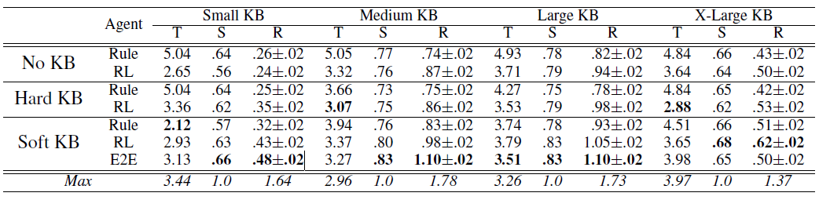
Experiments and Results
Simulated User Evaluation
T: Average number of turns. S: Success rate. R: Average reward
Notes:
说明：
For the RL and E2E agents, during training we fix the model every 100 updates and run 2000 simulations with greedy action selection to evaluate its performance. Then after training we select the model with the highest average reward and run a further 5000 simulations and report the performance in Table 2.
For reference we also show the performance of an agent which receives perfect information about the user target without any errors, and selects actions based on the entropy of the slots (Max). This can be considered as an upper bound on the performance of any agent (Wu et al., 2015).
结果分析：
Soft-KB平均回报最好。
Soft-KB下E2E>RL>Rule。
E2E在X-Large KB下不好，因为action空间指数级增长，所以未来工作关注改善E2E设置。
难度取决于entity数和slot不同value数，所以“Small”和 “X-Large” 设置下平均回报低。
修改reward signal，可在平均轮数(turns)和成功率之间平衡；有全部信息能帮助agent选择更好策略。
强化学习选择的策略更好，是因为自然语言输入是有噪音的，无噪音情况下规则是最优的。

Slide 19
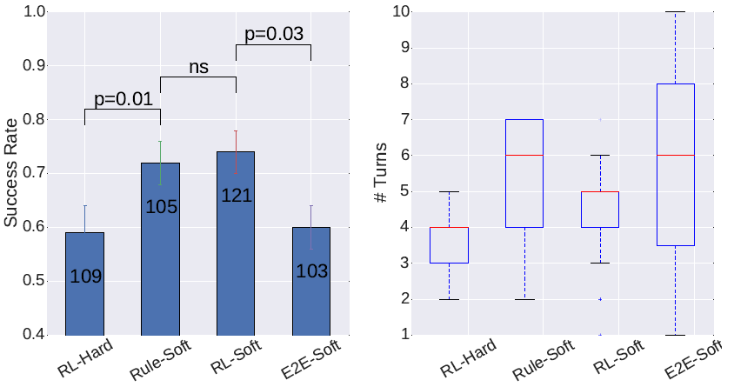
Experiments and Results
Human Evaluation
prone to overfitting
Notes:
结果分析：
Rule-Soft和RL-Soft成功率高
后者用的轮数少
E2E不好，因为过拟合倾向；未来可研究更好结构，或在其他数据上另外训练等

Slide 20
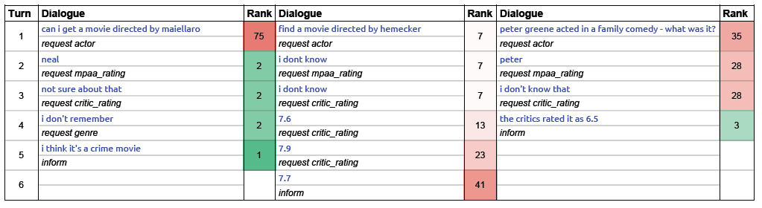
Experiments and Results
Human Evaluation
RL-Soft version
Rank denotes the rank of the target movie in the KB-posterior after each turn

Slide 21
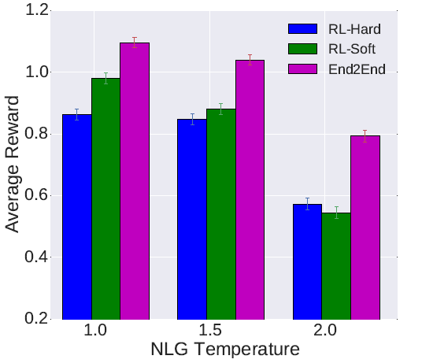
Experiments and Results
Human Evaluation
A higher temperature means a more uniform output distribution, which leads to generic simulator responses irrelevant to the agent questions.
This is a simple way of introducing noise in the utterances.
E2E system exhibits the strongest learning capability.
Such adaptation is key to the personalization of dialogue agents.

Slide 22
THANKS
Ni Yihan

Slide 23

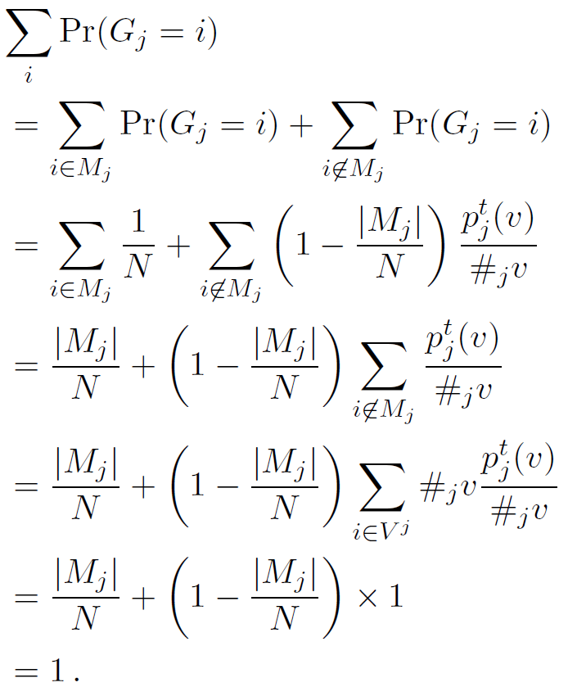
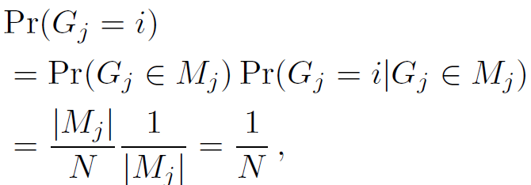
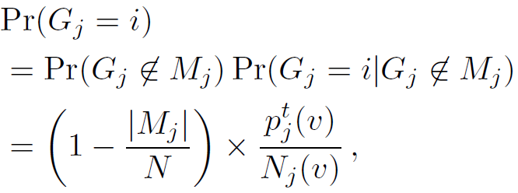
Derivation of
Verifying it sums to 1
return

Slide 24
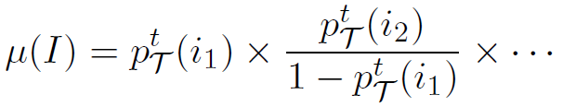
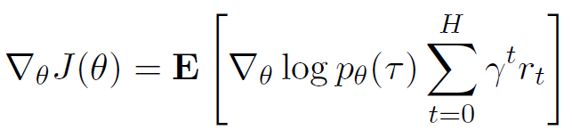
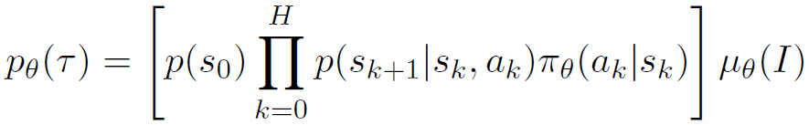
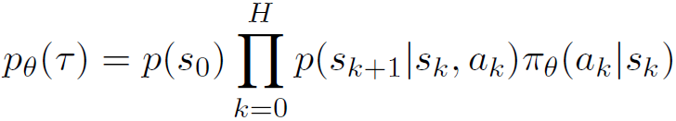
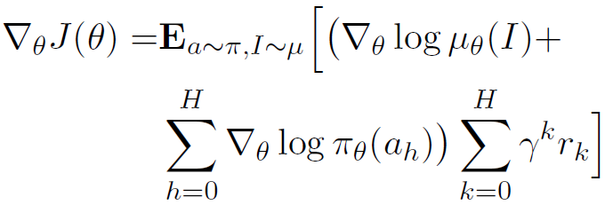
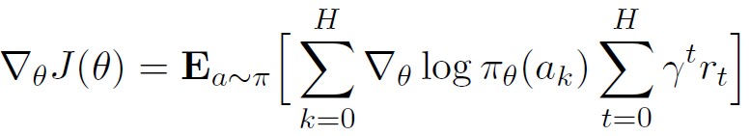
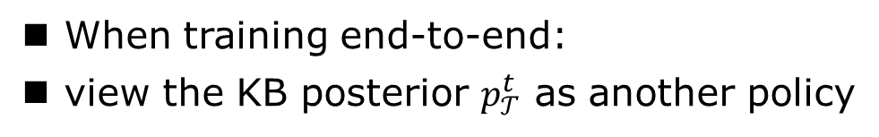
When training end-to-end:
view the KB posterior $p_{𝒯}^{t}$ as another policy
the likelihood ratio trick (Glynn, 1990)
Similarly,
Markovian assumption
Hence,
return
Notes:
因为要训练belief tracker，所以后验p也看作策略

